Slide 1


Player vs Player
Change Game Type
Player vs Computer
Player 1
Start the Game
Restart the Game
Place “X” on the Board
Place a Game Piece on the Game Board
Player 2
Place “O” on the Board
AI
Play Again After a Game is Completed

Slide 2
Populate Dropdowns
Select Player 1 from Dropdown 1
Populate Data Grid With H2H Data
Click Submit Button
Populate Data Grid With Player 1 Data Only
Database Application
User
Populate Data Grid With Player 2 Data Only
Select Player 2 From Dropdown 2
Clear Data Grid

Slide 3
Application
Database
User
Visit Webpage
Query for Unique Players
Unique Players
Populate Dropdowns
Select Options From Dropdowns and Click Submit
Query for Matches
Matches
Calculate Record
Display Data

Slide 4
matches
matchID | Int(11) | PKEY
matchDate | date
tournament | varchar(25)
winner | varchar(25)
loser | varchar(25)
Notes:
Activity Diagram. ...
Use Case Diagram. ...
Interaction Overview Diagram. ...
State Machine UML diagram. ...
Sequence UML Diagram. ...
Class Diagram. ...
Object Diagram. ...
Component Diagram.

Slide 5
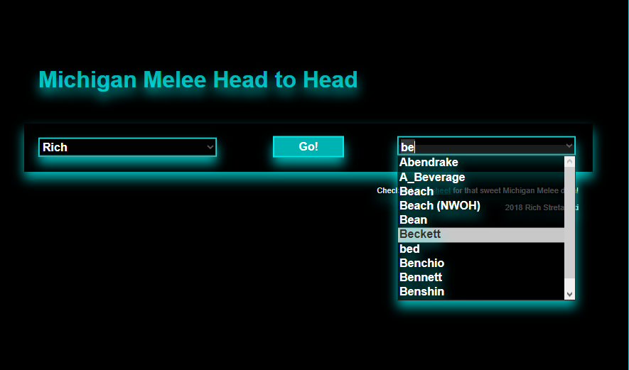
matches
Notes:
Activity Diagram. ...
Use Case Diagram. ...
Interaction Overview Diagram. ...
State Machine UML diagram. ...
Sequence UML Diagram. ...
Class Diagram. ...
Object Diagram. ...
Component Diagram.

